Slide 1

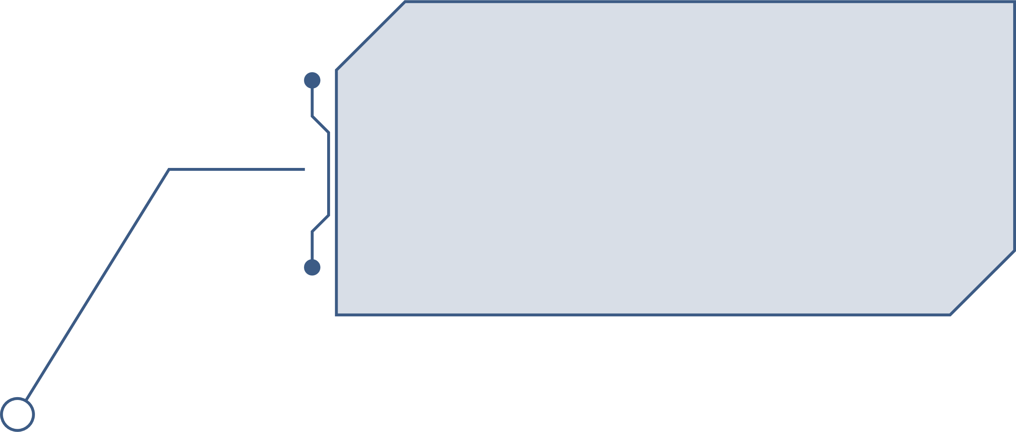
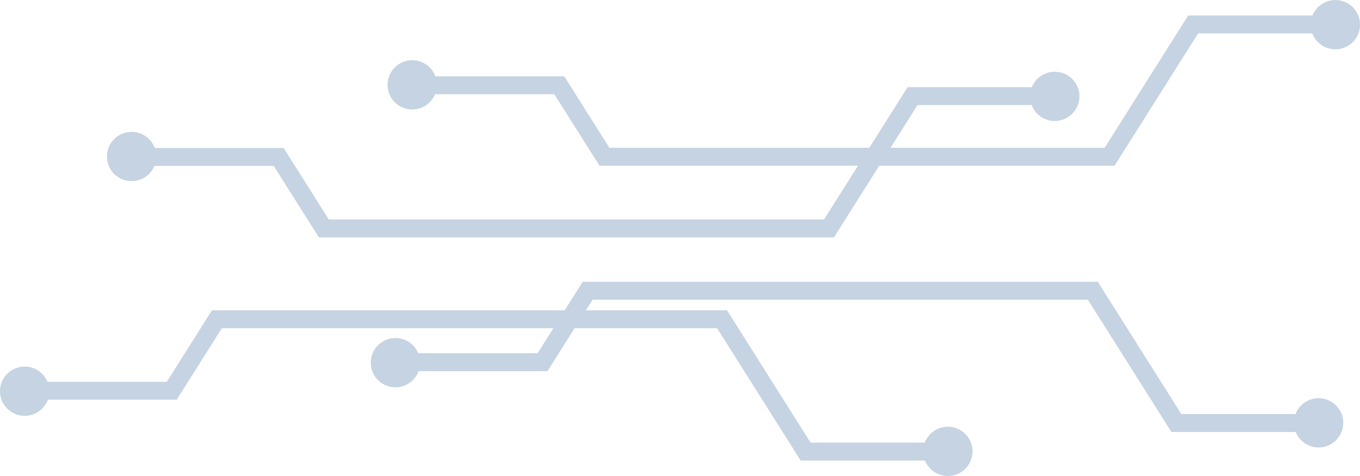

Heart Disease Prediction
Presented By:
Anshika Chaurasia
Manisha S

Slide 2

Introduction
Heart disease refers to various types of conditions that affect the heart’s structure and function. It is one of the leading causes of death globally. Common types include coronary artery disease, heart failure. With advancements in technology and data science, it has become possible to predict the likelihood of heart disease using machine learning models by analyzing medical parameters such as blood pressure, cholesterol levels, and more.
This project aims to use data analytics to assist healthcare professionals in early detection and risk analysis of heart disease in patients. Such models can act as a decision support system and help in timely diagnosis and treatment.

Slide 3
PROBLEM STATEMENT
Heart disease often goes undetected until it's too late. Traditional methods of diagnosis can be time-consuming, expensive, and dependent on specialist interpretation.
Problem: There is a need for a reliable, data-driven system that can assist in the early prediction of heart disease based on medical attributes. A predictive system will reduce diagnostic time, improve accuracy, and help in preventive care.

Slide 4
DATASET
Key Data Points Included:
Age: The age of the patient.
Sex: The sex of the patient (e.g., 1 for male, 0 for female).
Chest pain type: The type of chest pain experienced by the patient. This is often categorical (e.g., typical angina, atypical angina, non-anginal pain, asymptomatic). The numbers (1, 2, 3, 4) likely correspond to these categories.
BP: Resting blood pressure (in mm Hg).
Cholesterol: Serum cholesterol level (in mg/dl).
FBS over 120: Fasting blood sugar > 120 mg/dl (1 = true, 0 = false).
EKG results: Resting electrocardiographic results. The numbers (0, 1, 2) likely represent different categories Max HR: Maximum heart rate achieved.
Exercise angina: Exercise-induced angina (1 = yes, 0 = no).
ST depression: ST depression induced by exercise relative to rest.
Slope of ST: The slope of the peak exercise ST segment. The numbers (1, 2, 3) likely represent different slopes (e.g., upsloping, flat, downsloping).
Number of vessels fluro: Number of major vessels (0-3) colored by fluoroscopy.
Thallium: A thallium heart scan result. The numbers (e.g., 3, 6, 7) likely represent different outcomes.
Heart Disease: An indicator of the presence or absence of heart disease. "Presence" likely indicates the patient has heart disease, and "Absence" indicates they do not. The numbers (e.g., 0, 1) are also commonly used for this (e.g., 1 for presence, 0 for absence).

Slide 5
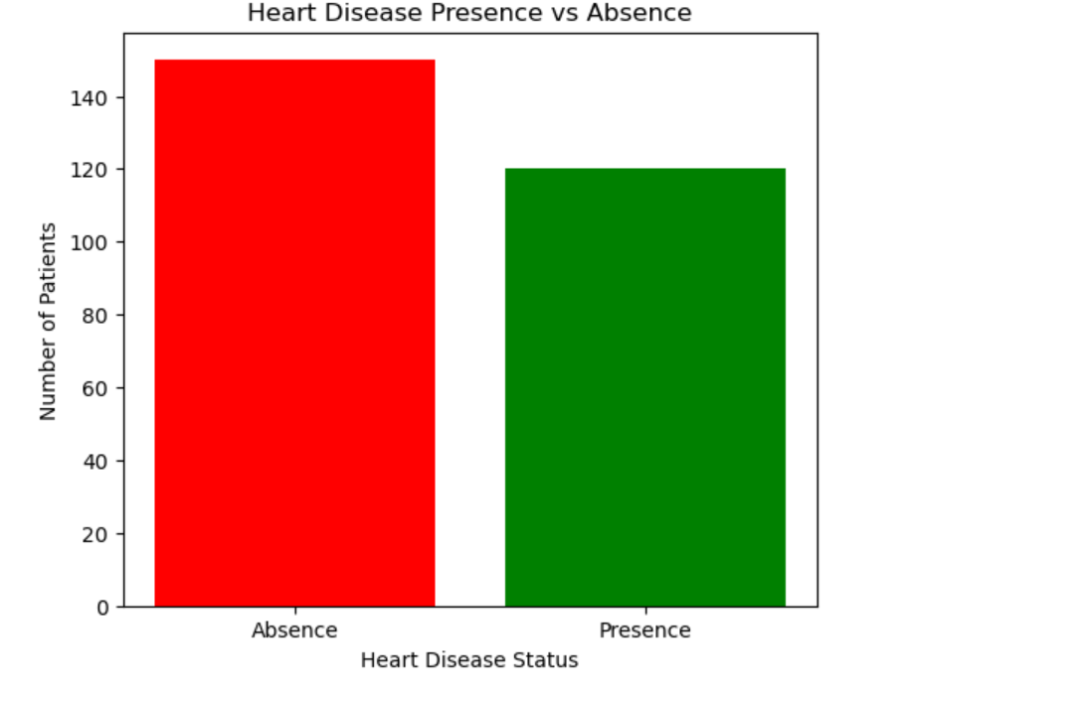
DATA VISUALIZATION
It’s an bar chart comparing how many patients fall into two groups:
Absence of heart disease – about 150 patients (red bar)
Presence of heart disease – about 120 patients (green bar)
So, in this dataset there are roughly 30 more people without heart disease than with it

Slide 6
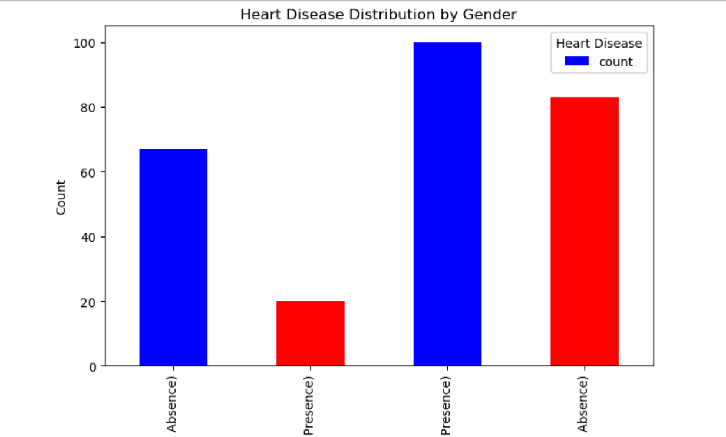
Chart type A grouped bar chart titled “Heart Disease Distribution by Gender.
- X‑axis: Gender categories, but they’re repeated twice— one set for “Absence” and one set for “Presence,” so the tick labels look like “Female (Absence), Female (Presence), Male (Presence), Male (Absence).” - Y‑axis: Patient count.

Slide 7
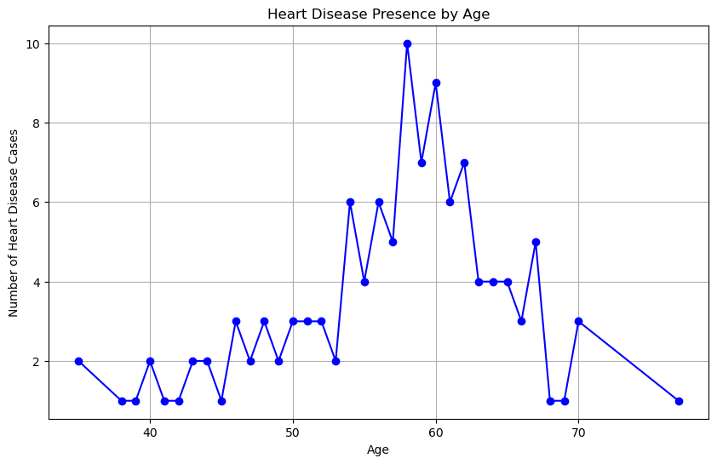
The line chart shows
Title: Heart Disease Presence by Age
X‑axis: Patient age (roughly 35 – 75 years).
Y‑axis: Number of diagnosed heart‑disease cases at each exact age.
Heart‑disease diagnoses are rare before 50, surge in the late‑50s and early‑60s, and then gradually taper as age increases past the mid‑60s.

Slide 8
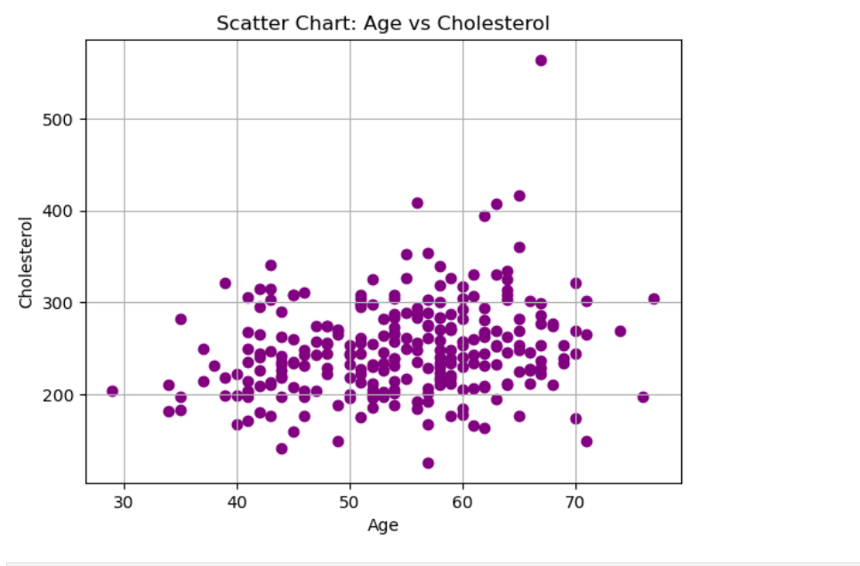
Scatter chart
X‑axis – Age: Patients span roughly 30 to 75 years old.
Y‑axis – Cholesterol: Blood‑cholesterol readings run from about 150 mg/dL up to just over 550 mg/dL.
Each purple dot is one patient.
Practical takeaway
Cholesterol levels vary a lot at every age group in this dataset.

Slide 9
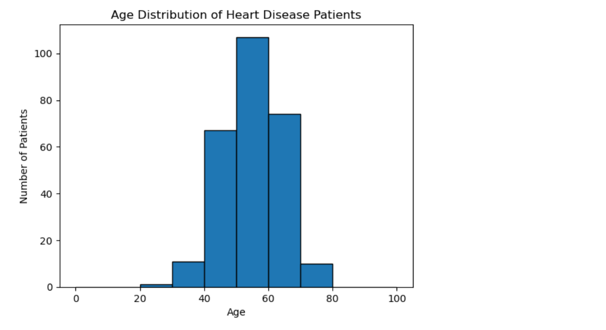
Histogram overview
Title: Age Distribution of Heart‑Disease Patients
Age bins: 0‑10, 10‑20, … up to 90‑100 years (10‑year width).
Y‑axis: Number of patients in each age band.
Take‑aways
Heart‑disease patients are overwhelmingly middle‑aged to early‑senior (40‑70 years).
The single largest cluster lies between 50 and 60 years.

Slide 10
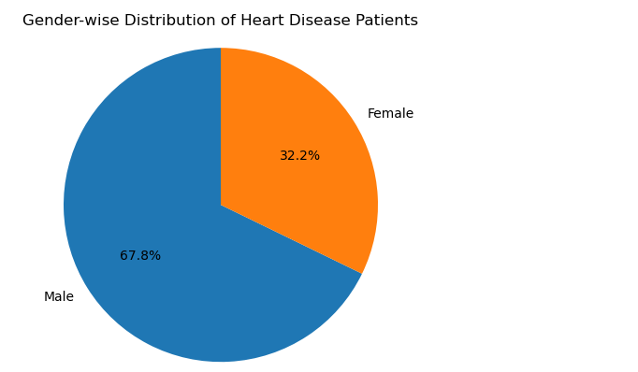
Pie Chart
The chart displays two slices:
A blue slice labeled "Male", representing 67.8% of the patients.
An orange slice labeled "Female", representing 32.2% of the patients.
The title of the chart is "Gender-wise Distribution of Heart Disease Patients". The chart visually emphasizes that there are more male heart disease patients than female patients in this dataset.

Slide 11
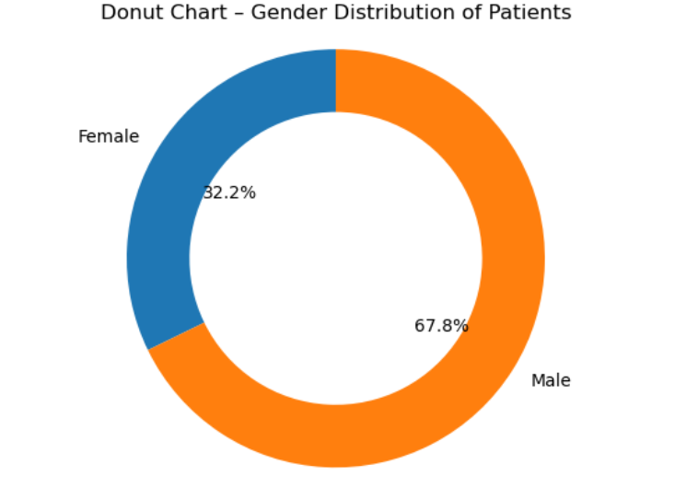
The title of the chart is "Donut Chart - Gender Distribution of Patients".
A blue segment representing "Female", which constitutes 32.2% of the patients. An orange segment representing "Male", which constitutes 67.8% of the patients.

Slide 12
Future Enhancements
Integration with Electronic Health Records (EHR): Automate data collection by integrating with hospital EHR systems to fetch real-time data.
Explainable AI (XAI): Implement explainability tools (like SHAP or LIME) to help doctors understand why the model predicted a certain outcome.
Mobile Health App: Develop a mobile application that allows users to monitor their heart health regularly using wearable devices (e.g., Fitbit, Apple Watch).
Real-Time Monitoring and Alerts: Use IoT and sensors to enable real-time heart monitoring and immediate alerts for abnormalities.
Multi-Disease Prediction Model: Expand the system to predict other diseases like diabetes, stroke, or kidney disease using similar data parameters.
Clinical Trials and Validation: Collaborate with hospitals for real-world testing, validation, and regulatory approval of the model.

Slide 13


CONCLUSION
The early detection of heart disease is critical to preventing fatal outcomes and improving the quality of life for patients. In this project, we developed a data analysis using data-driven approach to analyze key health indicators and assess the risk of heart disease. The model aims to assist healthcare providers in making faster and more accurate diagnoses.
This project not only addresses an urgent medical need but also demonstrates the potential of artificial intelligence in transforming healthcare delivery. With future enhancements like integration with wearables, real-time monitoring, and explainable AI, this system can evolve into a powerful tool for both clinicians and patients.

Slide 14
THANKYOU

